Slide 1

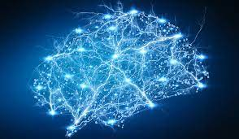
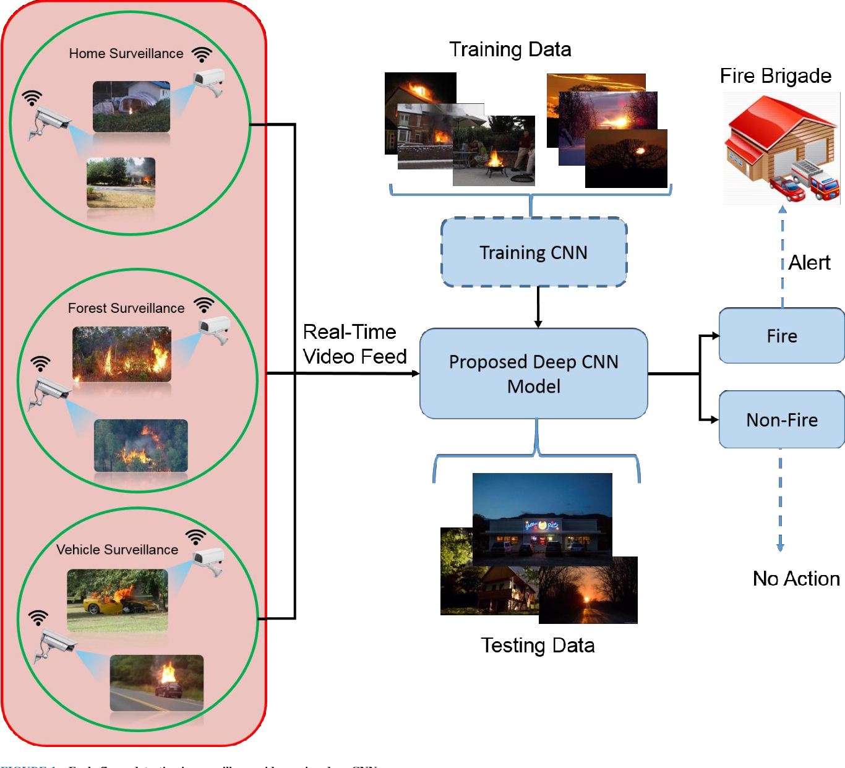
ADVANCING
FIRE DETECTION
WITH
CNN
Presented By = Ashirbad Pradhan
PGDA-31 Batch

Slide 2

ADVANCING
FIRE DETECTION
WITH
CNN
Presented By = Ashirbad Pradhan
PGDA-31 Batch

Slide 3


ADVANCING FIRE DETECTION WITH CNN
Real – Time Image Feed

Slide 4
ADVANCING FIRE DETECTION WITH CNN
Real – Time Image Feed

Slide 5
REASON FOR CHOOSING THE PROJECT
PROBLEM STATEMENT
The project' s core aim is to design an advanced system utilizing Convolutional Neural Networks (CNNs) to precisely detect instances of fire within surveillance camera.
Early fire detection enables quick emergency responses, minimizing damage.
Project contributes to safeguarding lives and property.
Leveraging AI for fire detection showcases cutting-edge technology application

Slide 6
PROBLEM STATEMENT
The project' s core aim is to design an advanced system utilizing Convolutional Neural Networks (CNNs) to precisely detect instances of fire within surveillance camera.
REASON FOR CHOOSING THE PROJECT
Early fire detection enables quick emergency responses, minimizing damage.
Project contributes to safeguarding lives and property.
Leveraging AI for fire detection showcases cutting-edge technology application

Slide 7
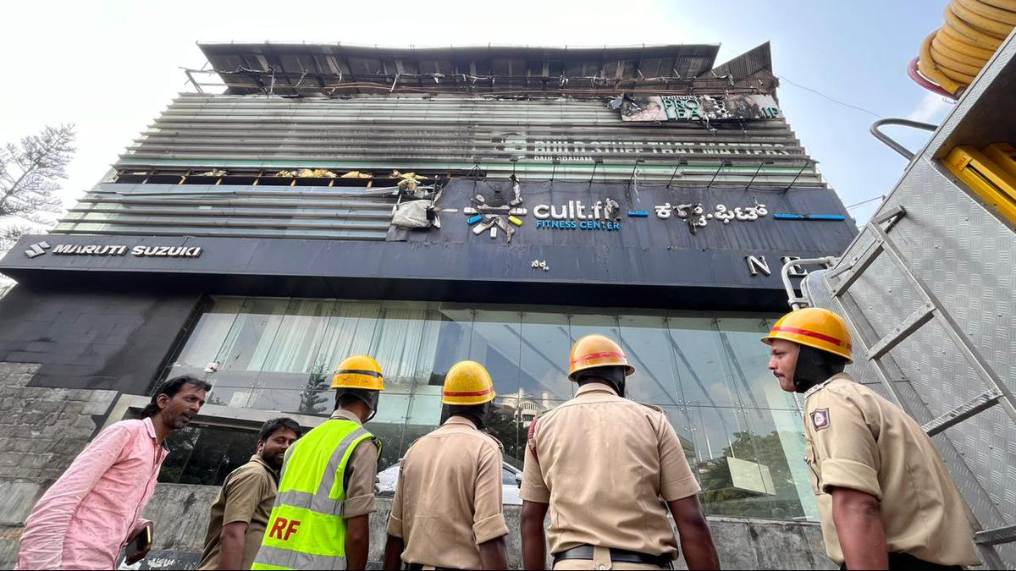
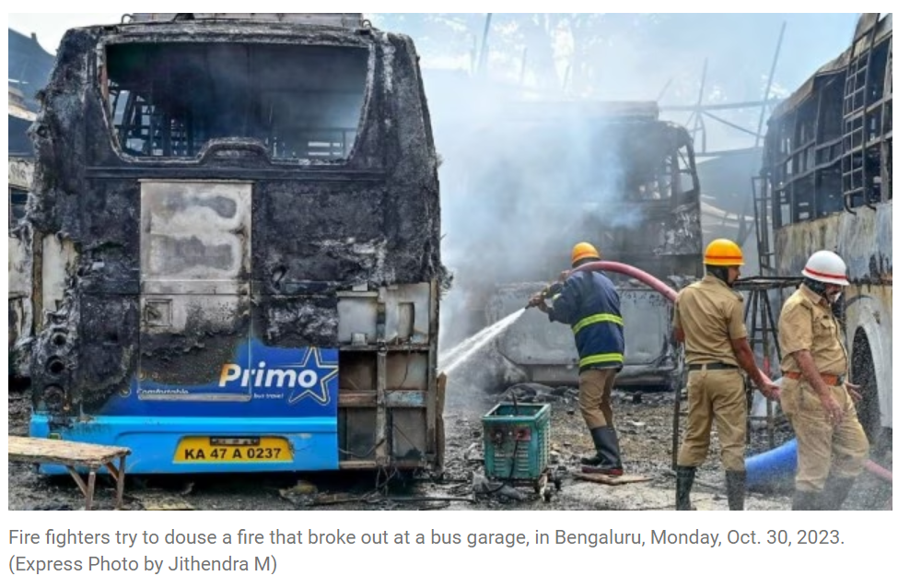
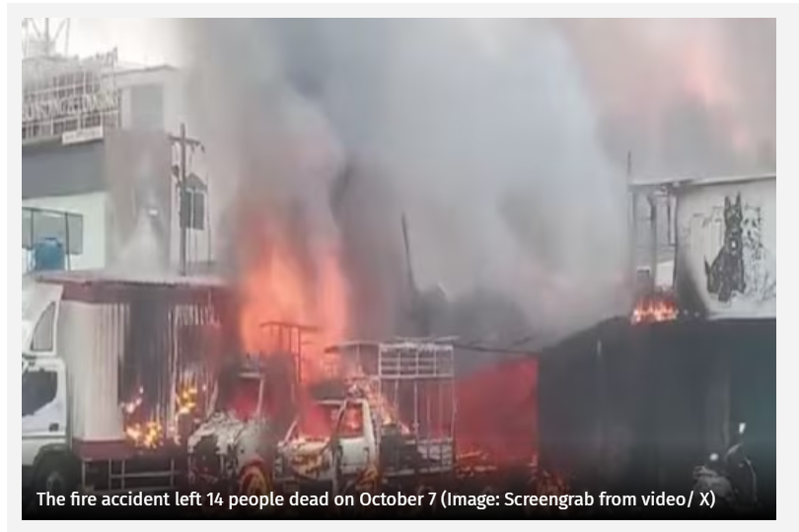
NEWS ARTICLES
Bengaluru | Fire engulfs Mudpipe cafe in Koramangala, employee jumps out of building,
Oct 18 2023.
The fire at the S.V. Coach Works, a bus workshop where around 30 buses were parked, was reported at 11 a.m. Soon after, explosions were heard, triggering panic among people in the vicinity.
Death Toll in Fire Incident at Cracker Godown in Bengaluru Rises to 16, Oct 12,2023

Slide 8
NEWS ARTICLES
Bengaluru | Fire engulfs Mudpipe cafe in Koramangala, employee jumps out of building,
Oct 18 2023.
The fire at the S.V. Coach Works, a bus workshop where around 30 buses were parked, was reported at 11 a.m. Soon after, explosions were heard, triggering panic among people in the vicinity.
Death Toll in Fire Incident at Cracker Godown in Bengaluru Rises to 16, Oct 12,2023

Slide 9
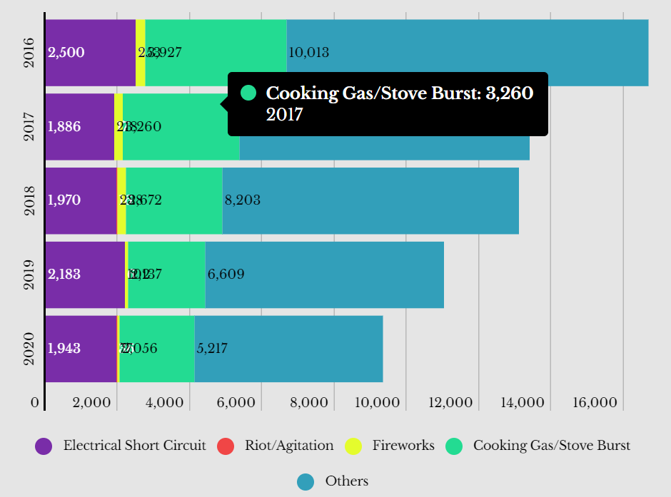
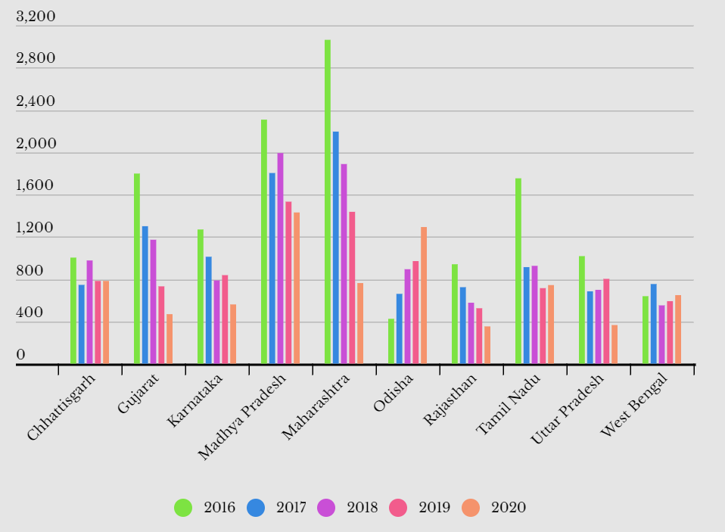
FIRE DATA STATISTICS
It is estimated that over 25,000 people die every year in India due to fire-related accidents. 66% of the people killed in such fires are women.
There are multiple reasons for electrical fires in residential, commercial or Industrial buildings such as overloading, loose connections, insulation damage, failure, poor quality of conductor, insulation and human error.

Slide 10
FIRE DATA STATISTICS
It is estimated that over 25,000 people die every year in India due to fire-related accidents. 66% of the people killed in such fires are women.
There are multiple reasons for electrical fires in residential, commercial or Industrial buildings such as overloading, loose connections, insulation damage, failure, poor quality of conductor, insulation and human error.

Slide 11
FIRE DATA STATISTICS
It is estimated that over 25,000 people die every year in India due to fire-related accidents. 66% of the people killed in such fires are women.
There are multiple reasons for electrical fires in residential, commercial or Industrial buildings such as overloading, loose connections, insulation damage, failure, poor quality of conductor, insulation and human error.

Slide 12
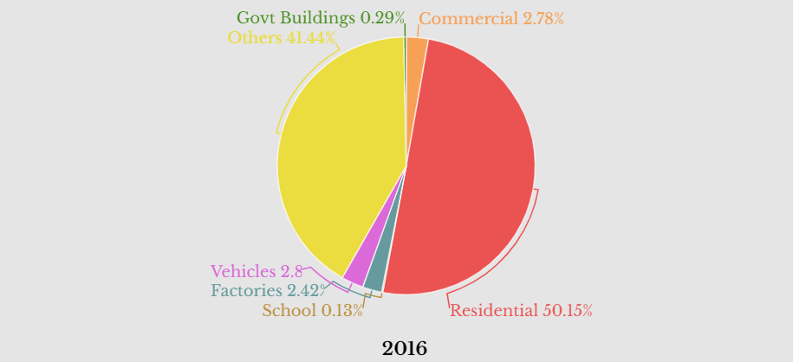
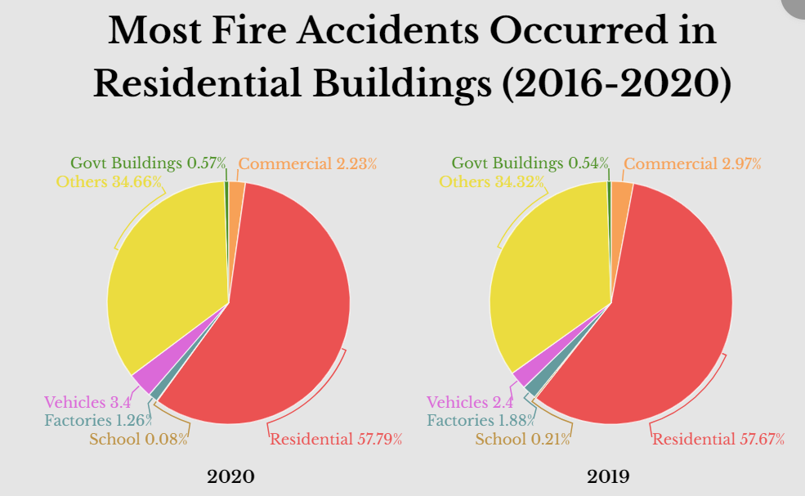
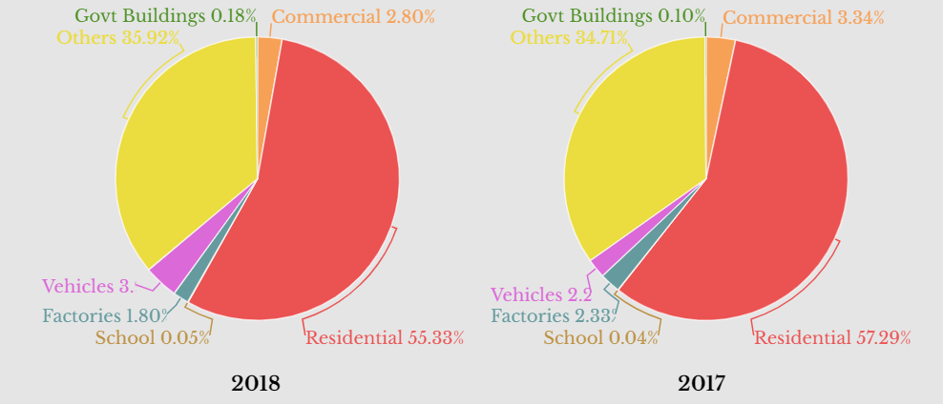
According to NCRB report most fire accident occurred in residential building.

Slide 13
According to NCRB report most fire accident occurred in residential building.

Slide 14
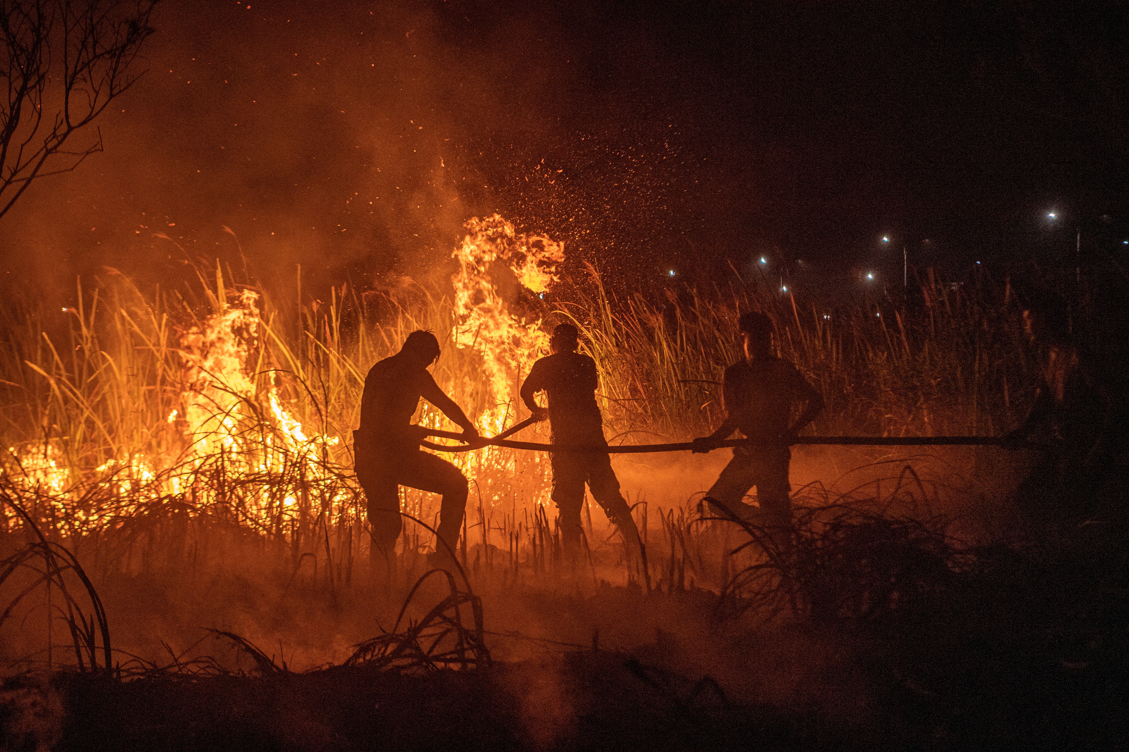
4.MODEL PERFORMANCE
CONTENT
1.INTRODUCTION
2.DATASET DESCRIPTION
5.CONCLUSION
6.SUGGESTIONS
3.METHODOLOGY

Slide 15
2.DATASET DESCRIPTION
CONTENT
1.INTRODUCTION
4.MODEL PERFORMANCE
5.CONCLUSION
6.SUGGESTIONS
3.METHODOLOGY

Slide 16
CONTENT
1.INTRODUCTION
2.DATASET DESCRIPTION
4.MODEL PERFORMANCE
5.CONCLUSION
6.SUGGESTIONS
3.METHODOLOGY

Slide 17
CONTENT
1.INTRODUCTION
2.DATASET DESCRIPTION
4.MODEL PERFORMANCE
3.METHODOLOGY
5.CONCLUSION
6.SUGGESTIONS

Slide 18
CONTENT
1.INTRODUCTION
2.DATASET DESCRIPTION
3.METHODOLOGY
4.MODEL PERFORMANCE
5.CONCLUSION
6.SUGGESTIONS

Slide 19
CONTENT
1.INTRODUCTION
2.DATASET DESCRIPTION
3.METHODOLOGY
4.MODEL PERFORMANCE
5.CONCLUSION
6.SUGGESTIONS

Slide 20
CONTENT
1.INTRODUCTION
2.DATASET DESCRIPTION
3.METHODOLOGY
4.MODEL PERFORMANCE
5.CONCLUSION
6.SUGGESTIONS

Slide 21
INTRODUCTION
02
By swiftly identifying fire instances, the developed model contributes to proactively improving public safety and minimizing property damage.
01
Our project focuses on creating an automated system using CNNs to detect fire in real-time surveillance camera footage.
03
Leveraging cutting-edge technology, our solution has the potential to revolutionize fire detection by providing an early warning system that can prevent disasters and expedite emergency responses

Slide 22
INTRODUCTION
03
Leveraging cutting-edge technology, our solution has the potential to revolutionize fire detection by providing an early warning system that can prevent disasters and expedite emergency responses
01
Our project focuses on creating an automated system using CNNs to detect fire in real-time surveillance camera footage.
02
By swiftly identifying fire instances, the developed model contributes to proactively improving public safety and minimizing property damage.

Slide 23
INTRODUCTION
01
Our project focuses on creating an automated system using CNNs to detect fire in real-time surveillance camera footage.
02
By swiftly identifying fire instances, the developed model contributes to proactively improving public safety and minimizing property damage.
03
Leveraging cutting-edge technology, our solution has the potential to revolutionize fire detection by providing an early warning system that can prevent disasters and expedite emergency responses

Slide 24
The dataset of 10,003 images has been meticulously divided into training, validation, and test sets in a balanced ratio of 3:1:1.
Dataset Description
Among the 5,003 fire-related images, 2,567 have been generated synthetically. By overlaying fire images on video frames from Singapore ‘s roads.
The dataset consists of 6,003 training images, 2,000 validation images, and another 2,000 images for testing

Slide 25
The dataset of 10,003 images has been meticulously divided into training, validation, and test sets in a balanced ratio of 3:1:1.
Dataset Description
Among the 5,003 fire-related images, 2,567 have been generated synthetically. By overlaying fire images onto video frames from Singapore ‘s roads.
The dataset consists of 6,003 training images, 2,000 validation images, and another 2,000 images for testing

Slide 26
The dataset of 10,003 images has been meticulously divided into training, validation, and test sets in a balanced ratio of 3:1:1.
Dataset Description
Among the 5,003 fire-related images, 2,567 have been generated synthetically. By overlaying fire images onto video frames from Singapore ‘s roads.
The dataset consists of 6,003 training images, 2,000 validation images, and another 2,000 images for testing

Slide 27


METHODOLOGY
Fine-Tuning & Data Augmentation
Model Building
Transfer Learning
EDA & Data Processing
Model Evaluation

Slide 28
METHODOLOGY
Fine-Tuning & Data Augmentation
Model Building
Transfer Learning
EDA & Data Processing
Model Evaluation

Slide 29
METHODOLOGY
Fine-Tuning & Data Augmentation
Model Building
Transfer Learning
EDA & Data Processing
Model Evaluation

Slide 30
METHODOLOGY
Fine-Tuning & Data Augmentation
Model Building
Transfer Learning
EDA & Data Processing
Model Evaluation

Slide 31
METHODOLOGY
Fine-Tuning & Data Augmentation
Model Building
Transfer Learning
EDA & Data Processing
Model Evaluation

Slide 32
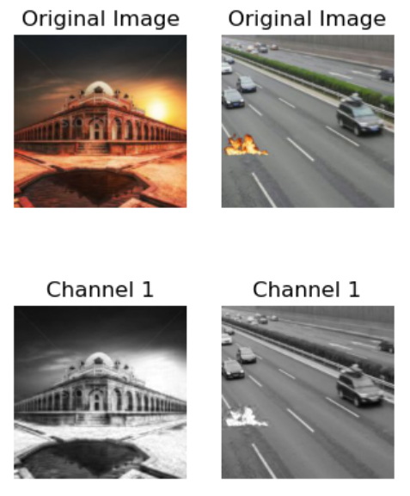
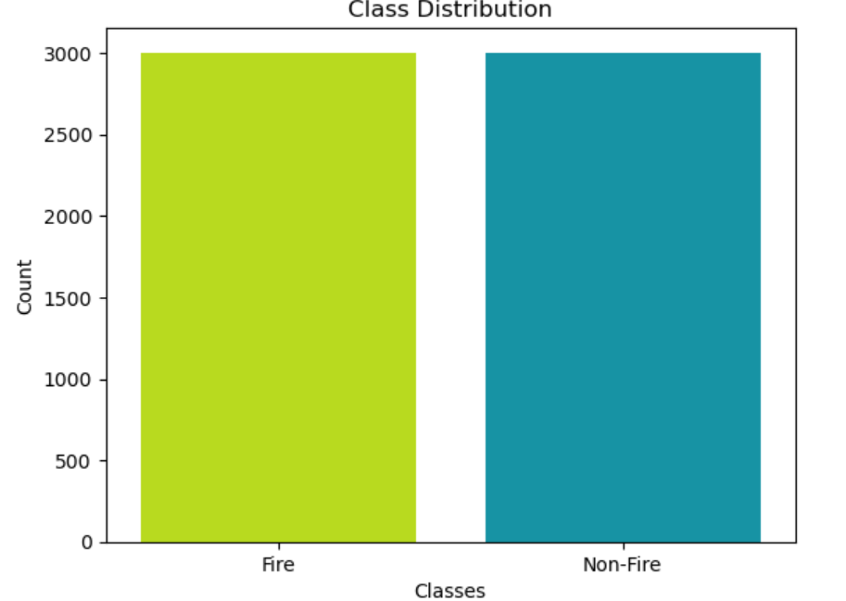
EDA Report
The EDA analysis revealed that the dataset contains a balanced distribution of fire and non-fire samples.
This analysis visually illustrates the differences in intensity of the initial color channel among the sample images, offering insights into potential patterns or distinctions in image content associated with that particular channel.

Slide 33
EDA Report
The EDA analysis revealed that the dataset contains a balanced distribution of fire and non-fire samples.
This analysis visually illustrates the differences in intensity of the initial color channel among the sample images, offering insights into potential patterns or distinctions in image content associated with that particular channel.

Slide 34
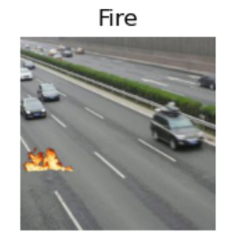
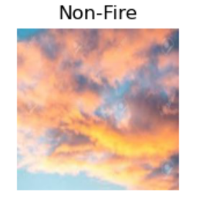
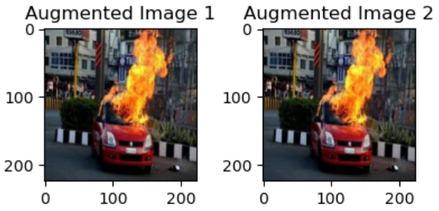
EDA Report
Utilizing matplotlib' s side-by-side visualization, we compared fire and non-fire images, facilitating a comprehensive understanding of their inherent data characteristics
Generated diverse images through augmentation techniques from a representative sample image of the selected class, highlighting increased data variation

Slide 35
EDA Report
Utilizing matplotlib' s side-by-side visualization, we compared fire and non-fire images, facilitating a comprehensive understanding of their inherent data characteristics
Generated diverse images through augmentation techniques from a representative sample image of the selected class, highlighting increased data variation

Slide 36
01
Model Validation
Data Preprocessing
Data Augmentation
MODEL BUILDING
Model Selection: For addressing the classification task at hand, the chosen deep learning architecture is a Convolutional Neural Network (CNN)
03
02
Model Evaluation
Accuracy, Loss, Precision, Recall
Confusion matrix
Visualization
Model Fine-Tuning
Experiment with different hyperparameters
Transfer Learning

Slide 37
MODEL BUILDING
01
Model Selection: For addressing the classification task at hand, the chosen deep learning architecture is a Convolutional Neural Network (CNN)
Model Validation
Data Preprocessing
Data Augmentation
Model Fine-Tuning
Experiment with different hyperparameters
Transfer Learning
03
02
Model Evaluation
Accuracy, Loss, Precision, Recall
Confusion matrix
Visualization

Slide 38
MODEL BUILDING
01
Model Selection: For addressing the classification task at hand, the chosen deep learning architecture is a Convolutional Neural Network (CNN)
Model Validation
Data Preprocessing
Data Augmentation
03
02
Model Evaluation
Accuracy, Loss, Precision, Recall
Confusion matrix
Visualization
Model Fine-Tuning
Experiment with different hyperparameters
Transfer Learning

Slide 39
MODEL BUILDING
01
Model Selection: For addressing the classification task at hand, the chosen deep learning architecture is a Convolutional Neural Network (CNN)
Model Validation
Data Preprocessing
Data Augmentation
03
02
Model Evaluation
Accuracy, Loss, Precision, Recall
Confusion matrix
Visualization
Model Fine-Tuning
Experiment with different hyperparameters
Transfer Learning

Slide 40
EVALUATION REPORT
CNN model evaluation involves assessing the performance and effectiveness of a Convolutional Neural Network through various metrics like accuracy, loss, and the confusion matrix and analyses to determine how well it predicts and solves the intended problem.
Train Accuracy
Validation Accuracy
Test Accuracy
False Positive
False Negative
Model
Precision
Recall
0.8562
0- 0.50
1- 0.50
0- 0.59
1- 0.41
405
596
CNN
0.9376
0.8305
Fine Tunning
0.8544
0- 0.86
1- 0.85
0- 0.84
1- 0.87
132
0.9912
0.8925
159
After Augmentation
0- 0.76
1- 0.73
0- 0.71
1- 0.77
290
226
0.9922
0.8288
0.7419
0- 0.51
1- 0.51
0- 0.60
1- 0.42
580
VGG-16
0.9771
0.8900
0.8881
399

Slide 41
EVALUATION REPORT
CNN model evaluation involves assessing the performance and effectiveness of a Convolutional Neural Network through various metrics like accuracy, loss, and the confusion matrix and analyses to determine how well it predicts and solves the intended problem.
Train Accuracy
Validation Accuracy
Test Accuracy
False Positive
False Negative
Model
Precision
Recall
0.8562
0- 0.50
1- 0.50
0- 0.59
1- 0.41
405
596
CNN
0.9376
0.8305
Fine Tunning
0.8544
0- 0.86
1- 0.85
0- 0.84
1- 0.87
132
0.9912
0.8925
159
After Augmentation
0- 0.76
1- 0.73
0- 0.71
1- 0.77
290
226
0.9922
0.8288
0.7419
0- 0.51
1- 0.51
0- 0.60
1- 0.42
580
VGG-16
0.9771
0.8900
0.8881
399

Slide 42
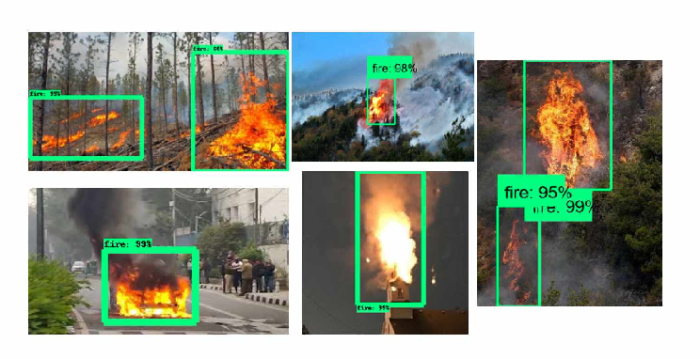
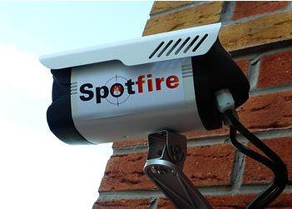
CONCLUSION
Fine-tuning approaches appear to yield the most promising results for fire detection through CCTV footage.
This technique not only enhance the models' overall accuracy but also ensure balanced performance in detecting fire instances, minimizing both false positives and false negatives
This finding underscore the potential of advanced model tuning in improving the efficiency of fire detection systems using surveillance camera feeds.

Slide 43
CONCLUSION
Fine-tuning approaches appear to yield the most promising results for fire detection through CCTV footage.
This technique not only enhance the models' overall accuracy but also ensure balanced performance in detecting fire instances, minimizing both false positives and false negatives
This finding underscore the potential of advanced model tuning in improving the efficiency of fire detection systems using surveillance camera feeds.

Slide 44
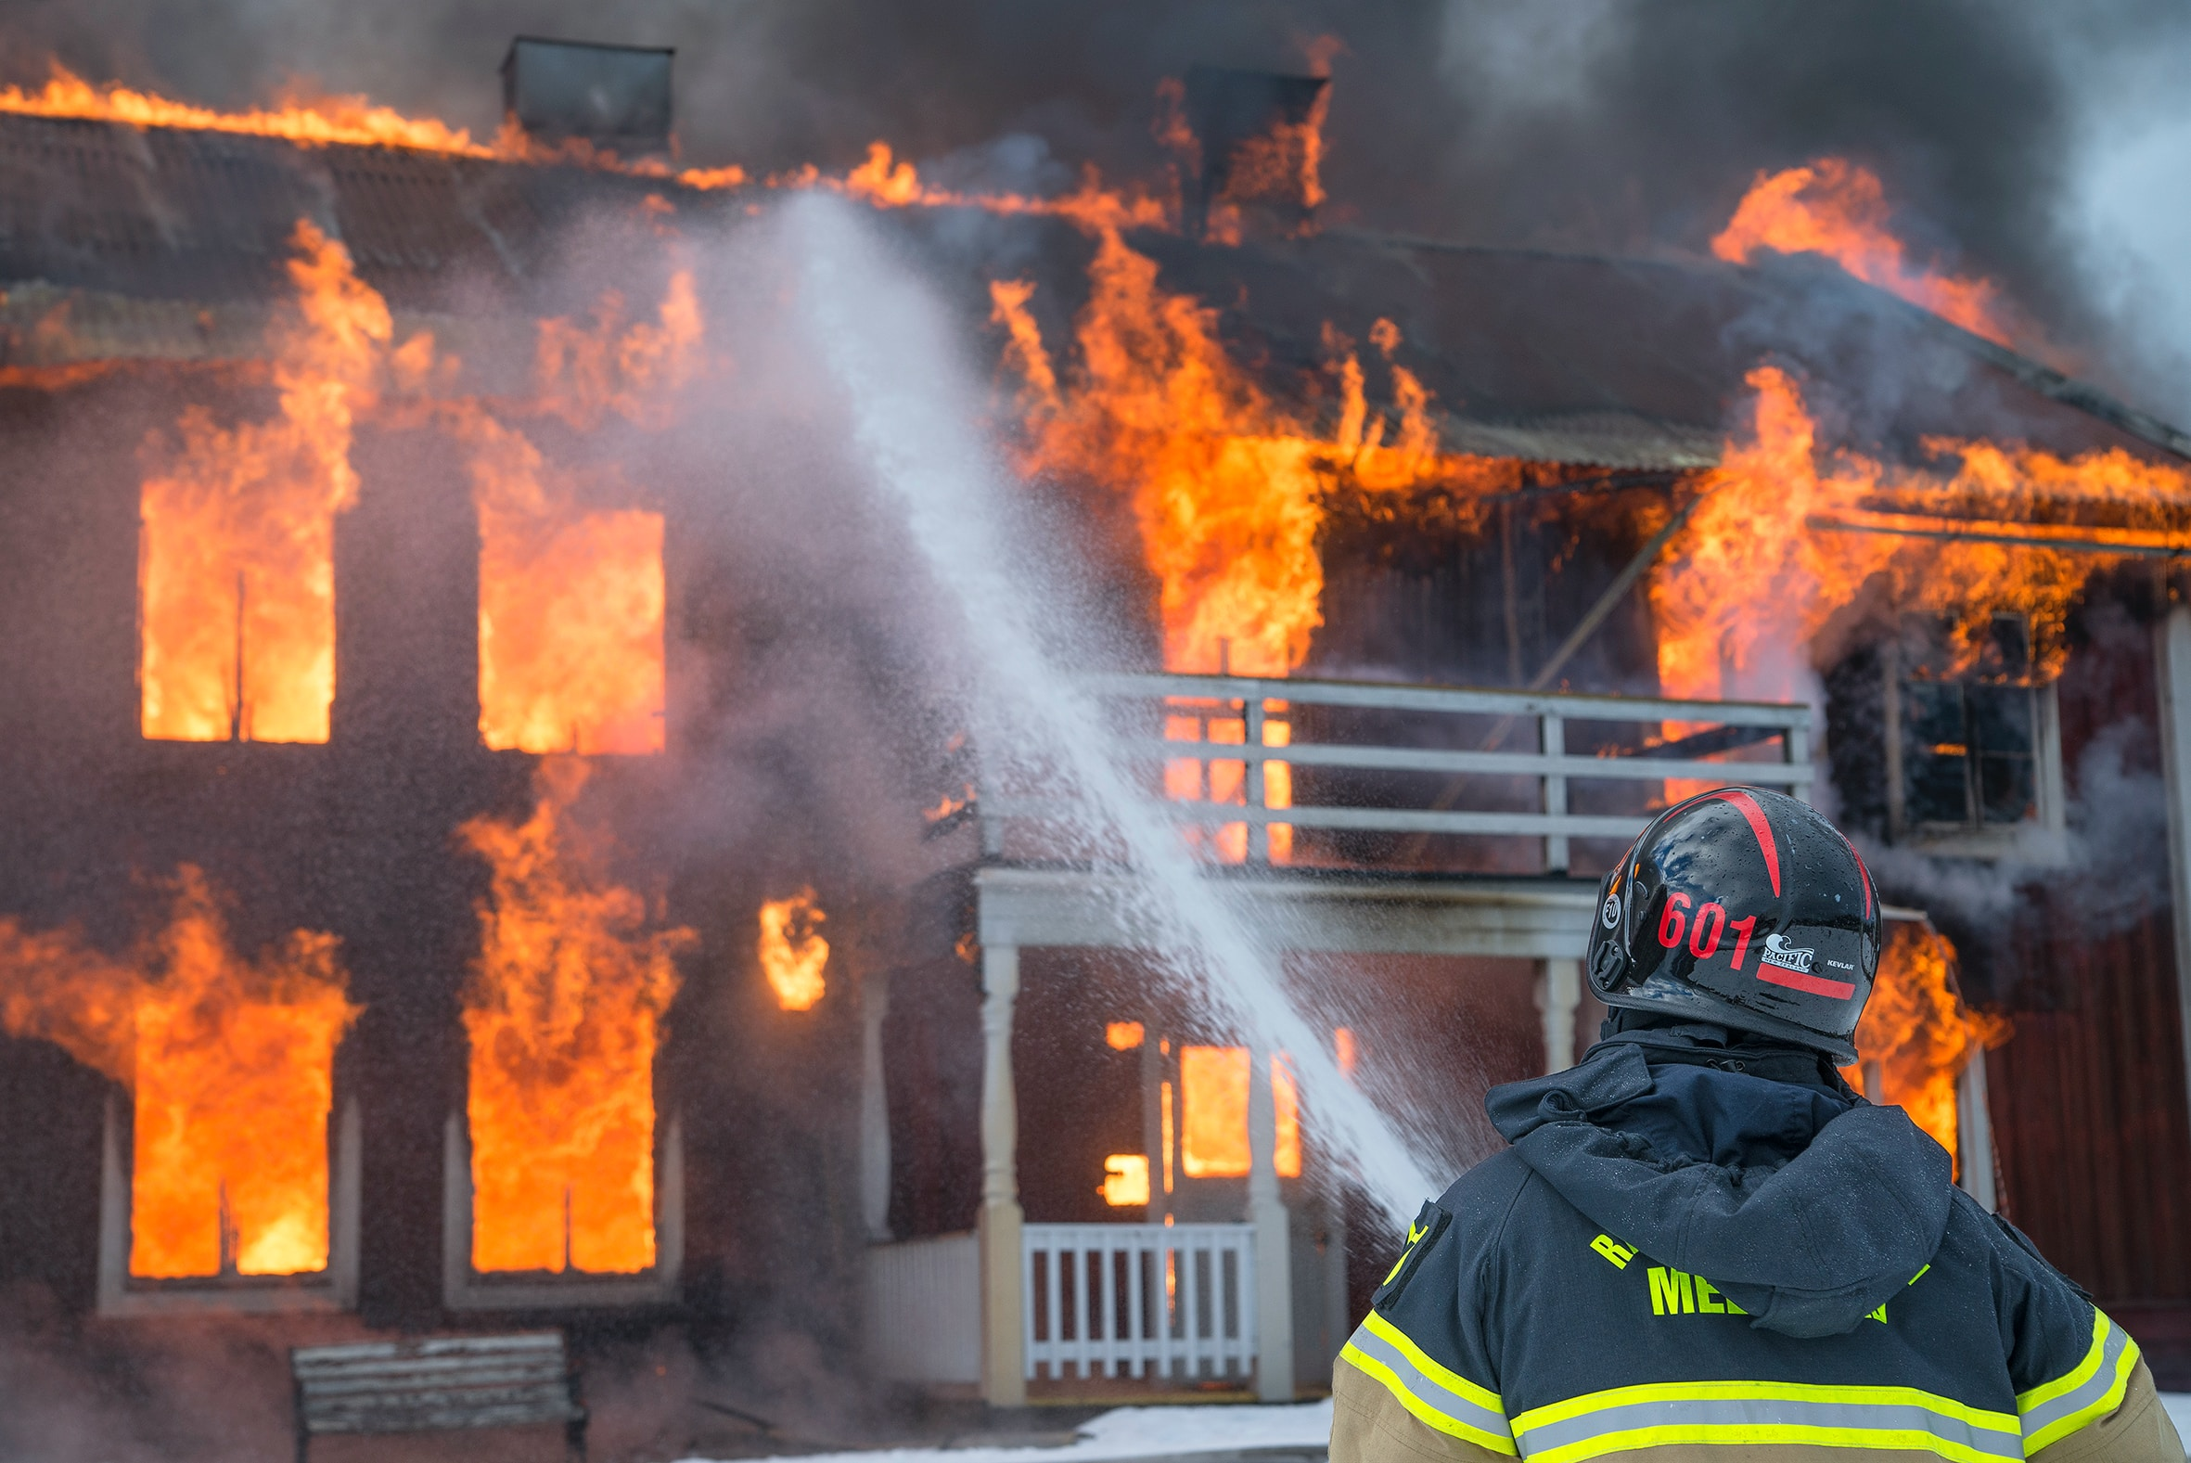
Suggestions
Diverse Environments
Multiclass Detection
Real-time Alerts
Anomaly Detection
Continuous Learning

Slide 45



THANK
YOU
Email id – ashirbadpradhan8115@gmail.com
Contact no - 6370111719

Slide 46
THANK
YOU
Email id – ashirbadpradhan8115@gmail.com
Contact no - 6370111719

